Slide 1
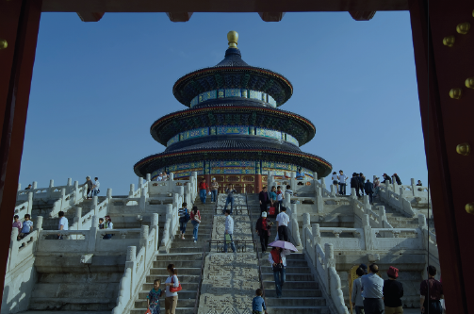
A Survey of Probability Concepts
Chapter 5
McGraw-Hill/Irwin
Copyright © 2012 by The McGraw-Hill Companies, Inc. All rights reserved.

Slide 2
Learning Objectives
LO1 Define probability.
LO2 Explain the terms experiment, event, outcome,
LO3 Identify and apply the appropriate approach to
assigning probabilities,
LO4 Calculate probabilities using the rules of addition,
LO5 Define the term joint probability,
LO6 Calculate probabilities using the rules of
multiplication,
LO7 Define the term conditional probability,
LO8 Calculate probabilities using a contingency table,
LO9 Calculate a probability using Bayes’ theorem,
LO10 Determine the number of outcomes using the
appropriate principle of counting.
5-<number>

Slide 3

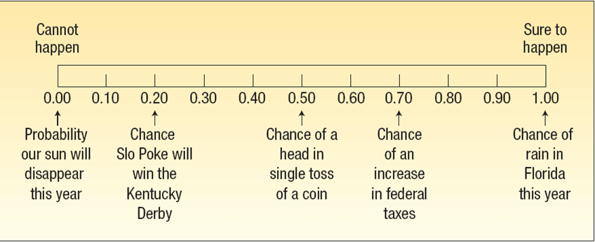
Probability
LO1 Define probability
PROBABILITY A value between zero and one, inclusive, describing the relative possibility (chance or likelihood) an event will occur.
5-<number>

Slide 4

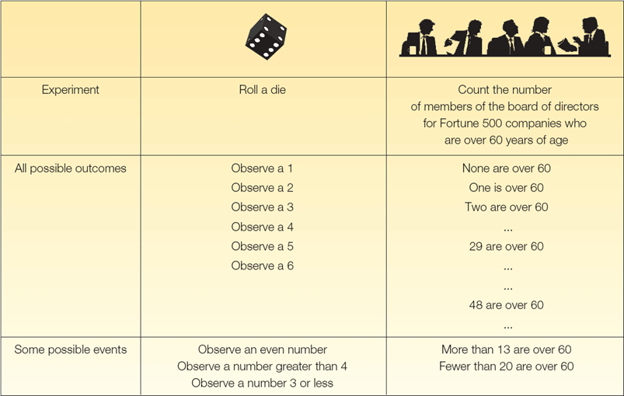
Experiment, Outcome and Event
LO2 Explain the terms experiment, event, outcome
An experiment is a process that leads to the occurrence of one and only one of several possible observations.
An outcome is the particular result of an experiment.
An event is the collection of one or more outcomes of an experiment.
5-<number>

Slide 5

Ways of Assigning Probability
LO3 Identify and apply the appropriate approach to assigning probabilities
There are three ways of assigning probability:
1. CLASSICAL PROBABILITY
Based on the assumption that the outcomes of an experiment are equally likely.
2. EMPIRICAL PROBABILITY
The probability of an event happening is the fraction of the time similar events happened in the past.
3. SUBJECTIVE CONCEPT OF PROBABILITY
The likelihood (probability) of a particular event happening that is assigned by an individual based on whatever information is available.
5-<number>

Slide 6

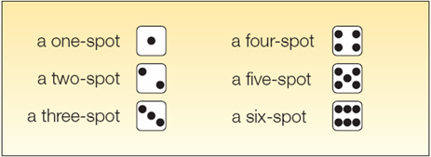
Classical Probability
LO3
Consider an experiment of rolling a six-sided die. What is the probability of the event “an even number of spots appear face up”?
The possible outcomes are:
There are three “favorable” outcomes (a two, a four, and a six) in the collection of six equally likely possible outcomes.
5-<number>

Slide 7
Mutually Exclusive Events and Collectively Exhaustive Events
LO3
Events are mutually exclusive if the occurrence of any one event means that none of the others can occur at the same time.
Events are independent if the occurrence of one event does not affect the occurrence of another. Events are collectively exhaustive if at least one of the events must occur when an experiment is conducted.
Events are collectively exhaustive if at least one of the events must occur when an experiment is conducted.
5-<number>

Slide 8
Empirical Probability
LO3
Empirical approach to probability is based on what is called the Law of Large Numbers.
Key to establishing probabilities empirically – larger number of observations provides a more accurate estimate of the probability.
5-<number>

Slide 9
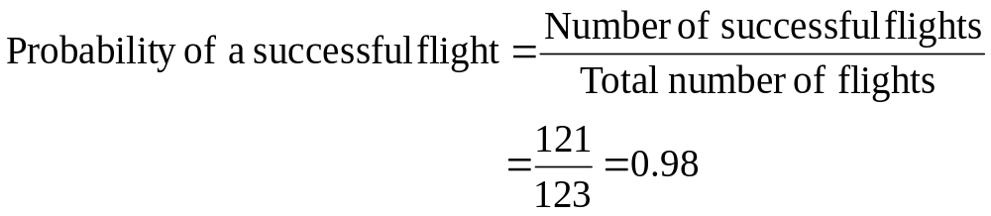
Empirical Probability - Example
LO3
On February 1, 2003, the Space Shuttle Columbia exploded. This was the second disaster in 123 space missions for NASA. On the basis of this information, what is the probability that a future mission is successfully completed?
5-<number>

Slide 10
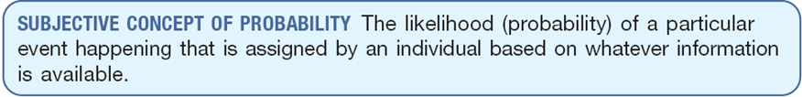
Subjective Probability - Example
LO3
If there is little or no past experience or information on which to base a probability, it may be arrived at subjectively.
Illustrations of subjective probability are:
  1. Estimating the likelihood the New England Patriots will play in the Super Bowl next year.
  2. Estimating the likelihood you will be married before the age of 30.
  3. Estimating the likelihood the U.S. budget deficit will be reduced by half in the next 10 years.
5-<number>

Slide 11
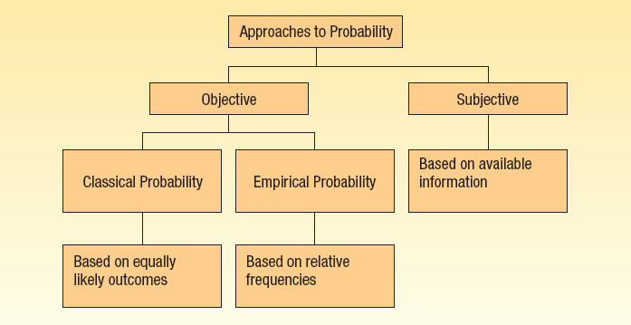
Summary of Types of Probability
LO3
5-<number>

Slide 12

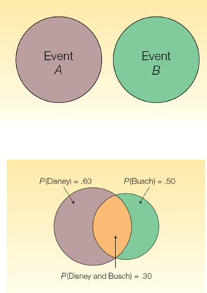
Rules of Addition for Computing Probabilities
LO4 Calculate probabilities using rules of addition.
Rules of Addition
Special Rule of Addition - If two events A and B are mutually exclusive, the probability of one or the other event’s occurring equals the sum of their probabilities.
P(A or B) = P(A) + P(B)
The General Rule of Addition - If A and B are two events that are not mutually exclusive, then P(A or B) is given by the following formula:
P(A or B) = P(A) + P(B) - P(A and B)
5-<number>

Slide 13
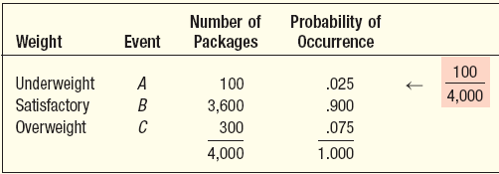
Addition Rule – Mutually Exclusive Events Example
LO4
An automatic Shaw machine fills plastic bags with a mixture of beans, broccoli, and other vegetables. Most of the bags contain the correct weight, but because of the variation in the size of the beans and other vegetables, a package might be underweight or overweight. A check of 4,000 packages filled in the past month revealed:
What is the probability that a particular package will be either underweight or overweight?
P(A or C) = P(A) + P(C) = .025 + .075 = .10
5-<number>

Slide 14
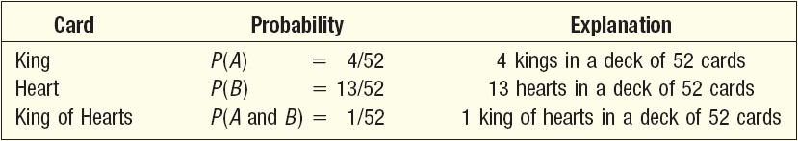
Addition Rule – Not Mutually Exclusive Events Example
LO4
What is the probability that a card chosen at random from a standard deck of cards will be either a king or a heart?
P(A or B) = P(A) + P(B) - P(A and B)
= 4/52 + 13/52 - 1/52
= 16/52, or .3077
5-<number>

Slide 15
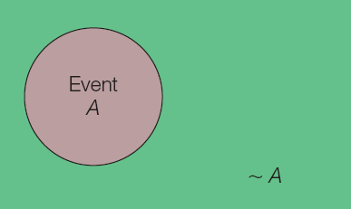
The Complement Rule
LO4
The complement rule is used to determine the probability of an event occurring by subtracting the probability of the event not occurring from 1.
P(A) + P(~A) = 1
or P(A) = 1 - P(~A).
5-<number>

Slide 16
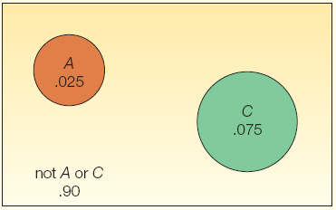
The Complement Rule - Example
LO4
An automatic Shaw machine fills plastic bags with a mixture of beans, broccoli, and other vegetables. Most of the bags contain the correct weight, but because of the variation in the size of the beans and other vegetables, a package might be underweight or overweight. Use the complement rule to show the probability of a satisfactory bag is .900
P(B) = 1 - P(~B)
= 1 – P(A or C)
= 1 – [P(A) + P(C)]
= 1 – [.025 + .075]
= 1 - .10
= .90
5-<number>

Slide 17
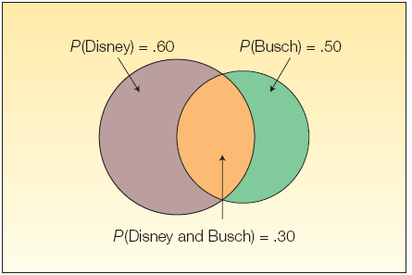
The General Rule of Addition
LO4
The Venn Diagram shows the result of a survey of 200 tourists who visited Florida during the year. The survey revealed that 120 went to Disney World, 100 went to Busch Gardens and 60 visited both.
What is the probability a selected person visited either Disney World or Busch Gardens?
P(Disney or Busch) = P(Disney) + P(Busch) - P(both Disney and Busch)
= 120/200 + 100/200 – 60/200
= .60 + .50 – .80
5-<number>

Slide 18

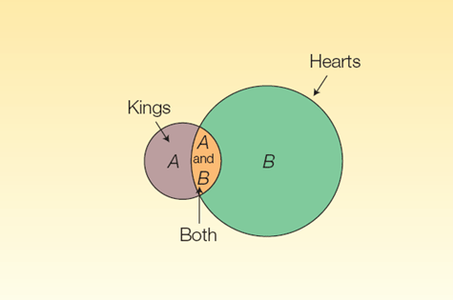
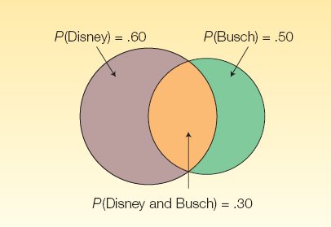
Joint Probability – Venn Diagram
LO5 Define the term joint probability.
JOINT PROBABILITY A probability that measures the likelihood two or more events will happen concurrently.
5-<number>
Notes:
.

Slide 19

Special Rule of Multiplication
LO6 Calculate probabilities using the rules of multiplication.
The special rule of multiplication requires that two events A and B are independent.
Two events A and B are independent if the occurrence of one has no effect on the probability of the occurrence of the other.
This rule is written: P(A and B) = P(A)P(B)
5-<number>
Notes:
.

Slide 20
Multiplication Rule-Example
LO6
A survey by the American Automobile association (AAA) revealed 60 percent of its members made airline reservations last year. Two members are selected at random. Since the number of AAA members is very large, we can assume that R₁ and R₂ are independent.
What is the probability both made airline reservations last year?
Solution:
The probability the first member made an airline reservation last year is .60, written as P(R₁) = .60
The probability that the second member selected made a reservation is also .60, so P(R₂) = .60.
Since the number of AAA members is very large, it can be assumes that R₁ and R₂ are independent.
P(R₁ and R₂) = P(R₁)P(R₂) = (.60)(.60) = .36
5-<number>

Slide 21

Conditional Probability
LO7 Define the term conditional probability.
A conditional probability is the probability of a particular event occurring, given that another event has occurred.
The probability of the event A given that the event B has occurred is written P(A|B).
5-<number>

Slide 22
General Multiplication Rule
LO7
The general rule of multiplication is used to find the joint probability that two independent events will occur.
It states that for two independent events, A and B, the joint probability that both events will happen is found by multiplying the probability that event A will happen by the conditional probability of event B occurring given that A has occurred.
5-<number>

Slide 23

General Multiplication Rule - Example
LO7
A golfer has 12 golf shirts in his closet. Suppose 9 of these shirts are white and the others blue. He gets dressed in the dark, so he just grabs a shirt and puts it on. He plays golf two days in a row and does not do laundry.
What is the likelihood both shirts selected are white?
The event that the first shirt selected is white is W₁. The probability is P(W₁) = 9/12
The event that the second shirt (W₂ )selected is also white. The conditional probability that the second shirt selected is white, given that the first shirt selected is also white, is P(W₂ | W₁) = 8/11.
To determine the probability of 2 white shirts being selected we use formula:
P(AB) = P(A) P(B|A)
P(W₁ and W₂) = P(W₁)P(W₂ |W₁) = (9/12)(8/11) = 0.55
5-<number>

Slide 24

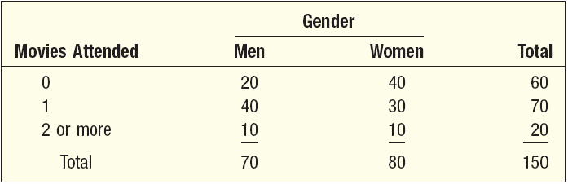
Contingency Tables
LO8 Calculate probabilities using a contingency table.
A CONTINGENCY TABLE is a table used to classify sample observations according to two or more identifiable characteristics
E.g. A survey of 150 adults classified each as to gender and the number of movies attended last month. Each respondent is classified according to two criteria—the number of movies attended and gender.
5-<number>

Slide 25
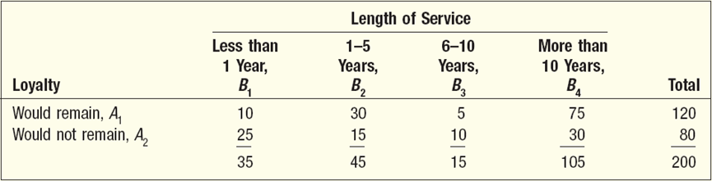
Contingency Tables - Example
LO8
A sample of executives were surveyed about their loyalty to their company. One of the questions was, “If you were given an offer by another company equal to or slightly better than your present position, would you remain with the company or take the other position?” The responses of the 200 executives in the survey were cross-classified with their length of service with the company.
What is the probability of randomly selecting an executive who is loyal to the company (would remain) and who has more than 10 years of service?
5-<number>

Slide 26

Contingency Tables - Example
LO8
Event A₁ - if a randomly selected executive will remain with the company despite an equal or slightly better offer from another company. Since there are 120 executives out of the 200 in the survey who would remain with the company
P(A₁) = 120/200, or .60
Event B₄ - if a randomly selected executive has more than 10 years of service with the company. Thus, P(B₄| A₁) is the conditional probability that an executive with more than 10 years of service would remain with the company. Of the 120 executives who would remain 75 have more than 10 years of service, so
P(B₄| A₁) = 75/120
5-<number>

Slide 27
Tree Diagrams
LO8
A tree diagram is:
useful for portraying conditional and joint probabilities.
particularly useful for analyzing business decisions involving several stages.
a graph that is helpful in organizing calculations that involve several stages.
Each segment in the tree is one stage of the problem. The branches of a tree diagram are weighted by probabilities.
5-<number>

Slide 28
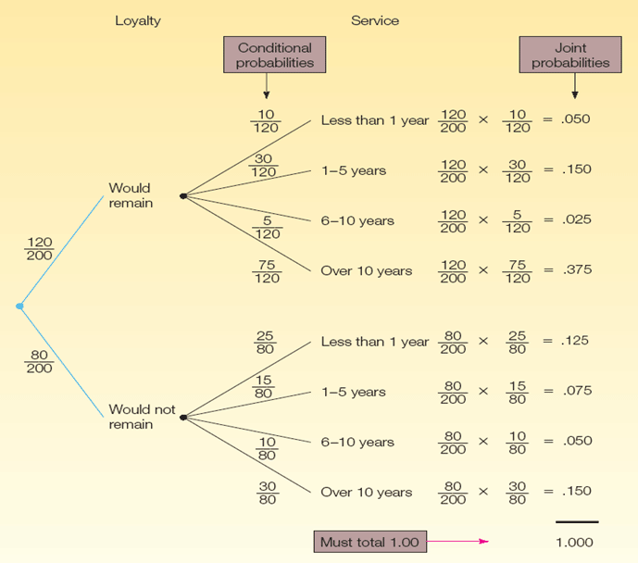
Tree Diagram Example
LO8
5-<number>

Slide 29

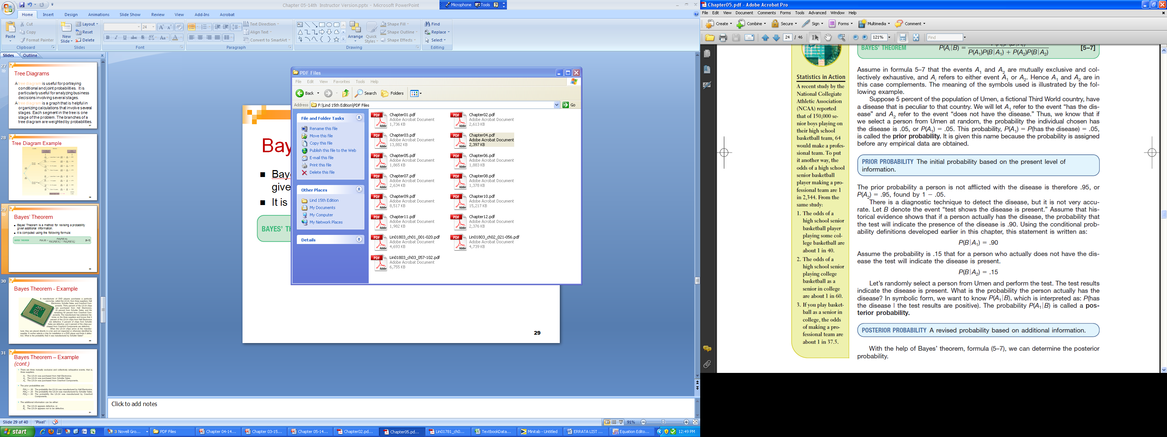
Bayes’ Theorem
LO9 Calculate probabilities using Bayes’ Theorem
Bayes’ Theorem is a method for revising a probability given additional information.
It is computed using the following formula:
5-<number>

Slide 30
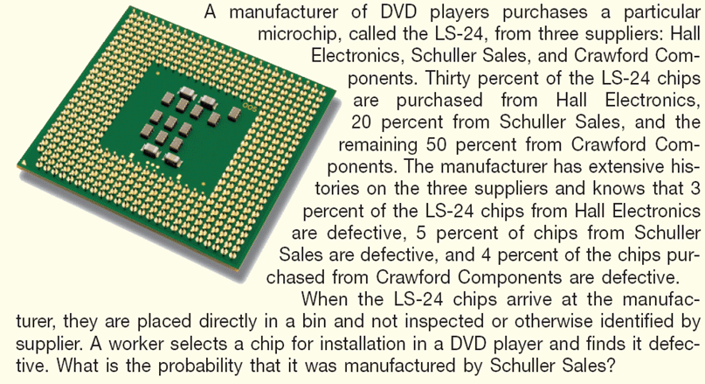
Bayes’ Theorem - Example
LO9
5-<number>

Slide 31
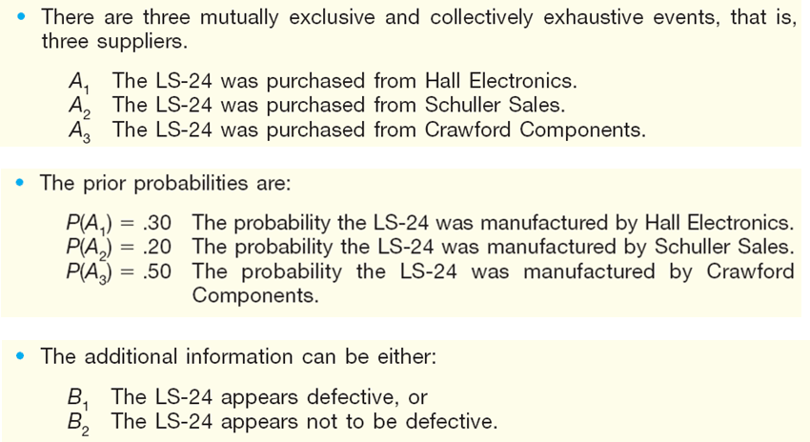
Bayes’ Theorem – Example (cont.)
LO9
5-<number>

Slide 32
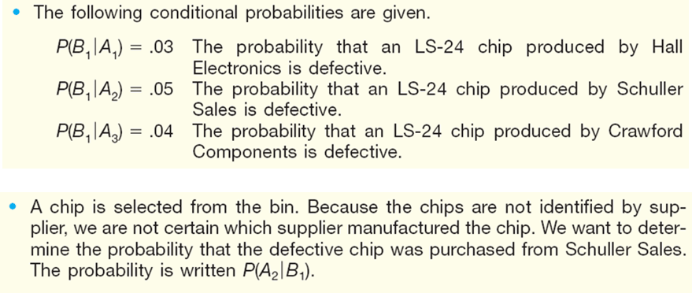
Bayes’ Theorem – Example (cont.)
LO9
5-<number>

Slide 33
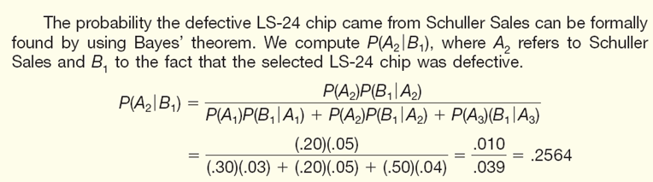
Bayes’ Theorem – Example (cont.)
LO9
5-<number>

Slide 34

Counting Rules – Multiplication
LO10 Determine the number of outcomes using the appropriate principle of counting.
The multiplication formula indicates that if there are m ways of doing one thing and n ways of doing another thing, there are m x n ways of doing both.
Example: Dr. Delong has 10 shirts and 8 ties. How many shirt and tie outfits does he have?
(10)(8) = 80
5-<number>

Slide 35

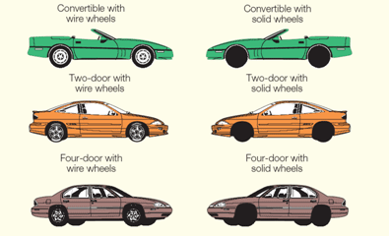

Counting Rules – Multiplication: Example
LO10
An automobile dealer wants to advertise that for $29,999 you can buy a convertible, a two-door sedan, or a four-door model with your choice of either wire wheel covers or solid wheel covers. How many different arrangements of models and wheel covers can the dealer offer?
5-<number>

Slide 36
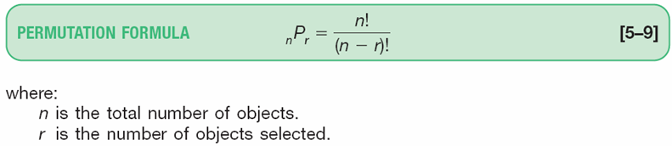
Counting Rules - Permutation
LO10
A permutation is any arrangement of r objects selected from n possible objects. The order of arrangement is important in permutations.
5-<number>

Slide 37

Counting - Combination
LO10
A combination is the number of ways to choose r objects from a group of n objects without regard to order.
5-<number>

Slide 38
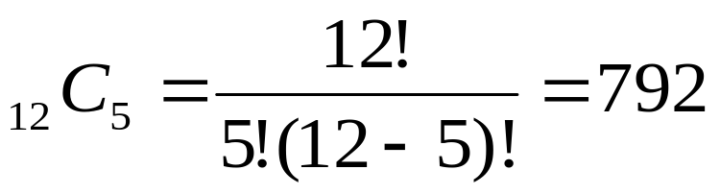
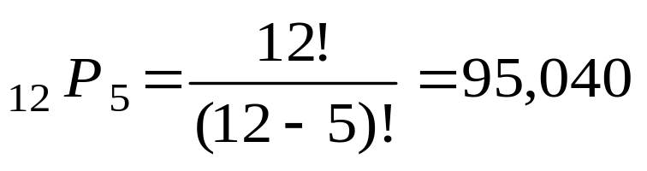
Combination and Permutation Examples
LO10
COMBINATION EXAMPLE
There are 12 players on the Carolina Forest High School basketball team. Coach Thompson must pick five players among the twelve on the team to comprise the starting lineup. How many different groups are possible?
PERMUTATION EXAMPLE
Suppose that in addition to selecting the group, he must also rank each of the players in that starting lineup according to their ability.
5-<number>

